Slide 1
MyoProtein
Lektor René Lametsch
University of Copenhagen
Microbiota
DTU
Nordic Sugar
Rootly
Planteslagteren

Slide 2
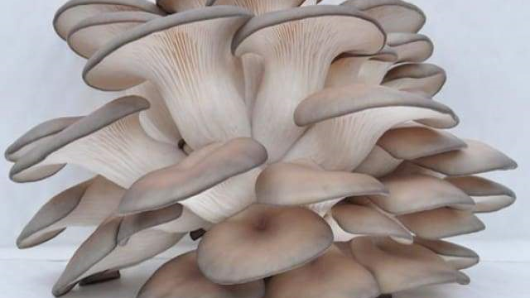
From Biomasse to Protein
Oyster (Pleurotus sapidus)

Slide 3
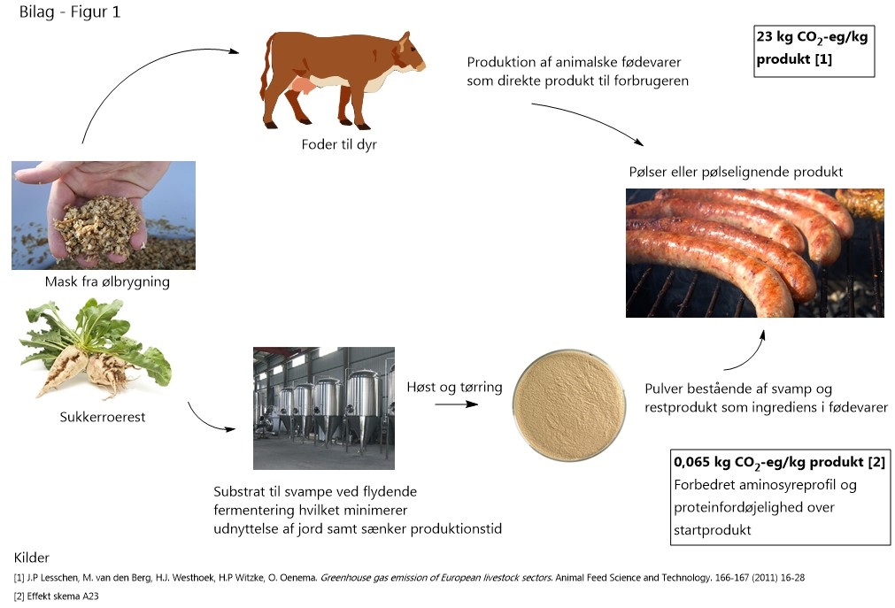
Sustainable mushroom fermentation

Slide 4
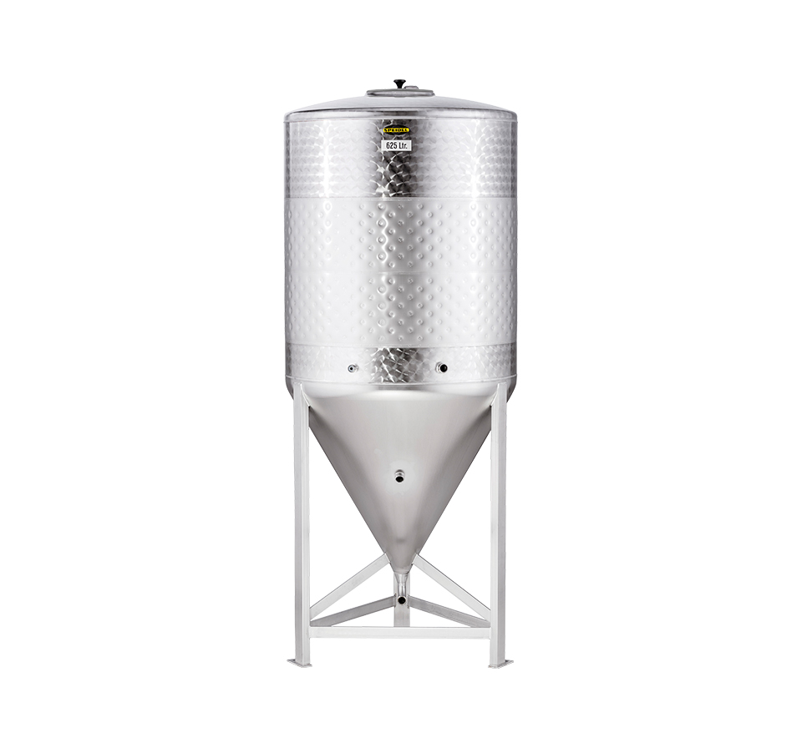
The answer is industrial
FERMENTATION
- a vertical production method -
Sustainability: New food and feed ingredients are produced on industrial wastestreams by fermentaion. Ex. Sugar beet pulp, juice pulp, fermentation slurry
Contribute to circular economy: Often will up till 50% of an agroindustrial crop end up as low value waste. Through fermentation we can valorize these waste streams and turn them into new products of high value.
Climate friendly production methods: Making proteins via feeding cows or a fermentation tank with biproducts makes a huge difference in CO2 release per kilo of produced protein as:
100 : 1
Green transformation of the food industry: Waste streams and new crops being transformed into new foods and other valuable products by fermentation will meet a demanding need for more proteins.
Zero waste: All the waste streams are fermented and used for new products. Water is recycled.

Slide 6


Transformation of a Sugar Factory into
(Nordic Sugar A/S)
Production per year:
476.000 tons sugar
324.000 tons bi-products
Sustainable industry
Circular economy
Valorized output
Healthy Foods

Slide 7
WP1: Rawmaterial Characterisation (KU/DTU)
Protein (aminoacid)
Fiber
IVPD
WP6: Product development (Rootly)
Taste
Product development
WP5: Pilot (MicroBiota)
500l
5000l
WP2: Pre-processering (DTU)
LAB Fermentering
WP7: Admin (KU)
WP3: Mushroom Fermentation (KU)
Mushroom Fermentation
Conversion rate
Time, pH, oxygen, temperature
WP4: Down stream (MicroBiota)
Filtration
Separation

Slide 8
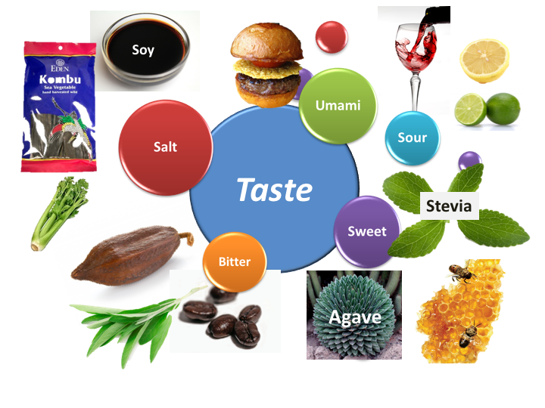
Taste – Basic taste
Major challenge in the green transition

Slide 9
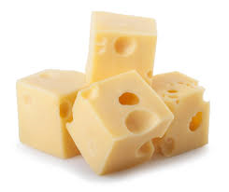
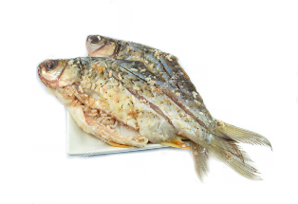
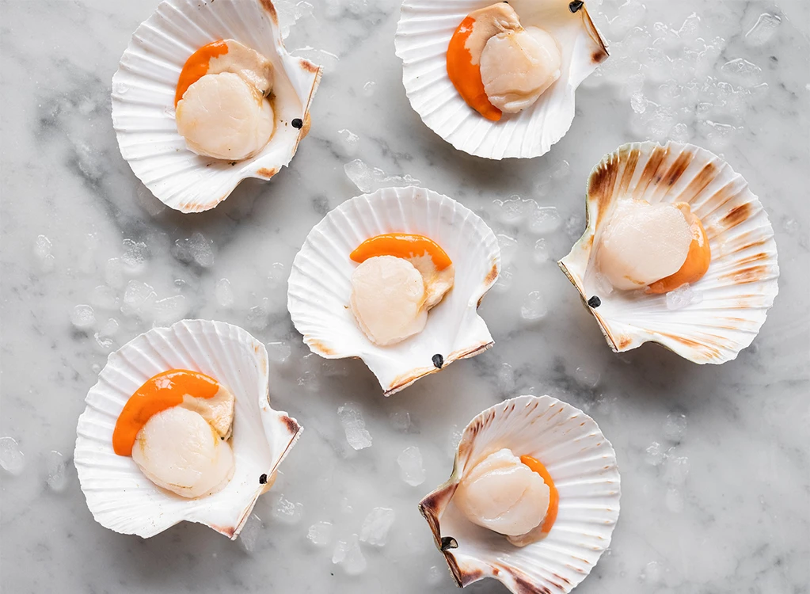
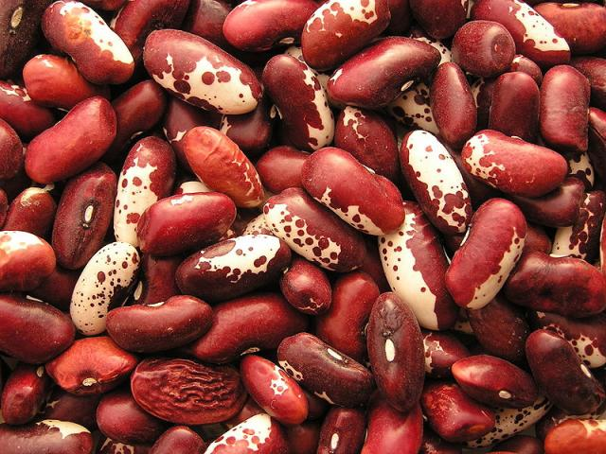
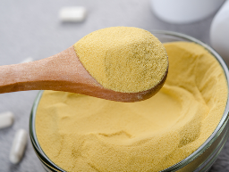
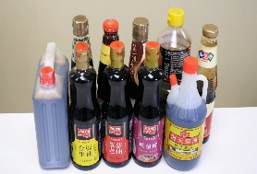
New taste sensation - Kokumi
The literal translation from Japanese is: rich (koku) taste (mi).
Kokumi is defined as a taste sensation associated with thickness, mouthfulness, continuity, taste-enhancing, and long-lasting characteristics (Ueda et al., 1990).
Foods with kokumi sensation

